Slide 1
Faculty of Engineering Department of Electrical Engineering and Computer Science Guided By : - 1. Prof. Dr.-Ing. habil. Olaf Simanski 2. Dipl.-Ing Uwe Starke
Special Aspects of Automation Technology
IOT Based Health Monitoring System
Prepared By : Group: 10
Ravikumar Pravinbhai Dhameliya 373306
Meet Pankajkumar Shah 381305

Slide 2
Contents
Abstract
IOT in Healthcare
Components
Working principle
Flow chart
Block Diagram
Source code
Hardware
Results
Future Scope

Slide 3
Abstract
In this project we aimed to develop a Smart Health Monitoring System with Internet of Thing (IoT). Portable healthcare monitoring systems with emerging technologies are becoming of great concern worldwide nowadays. This project proposes a smart health monitoring system in IoT environment that can monitor a patient’s basic health as well as the room temperature in real-time. In this system, using two sensors we capture data from Patient which are heart beat, O₂ level, room temperature and body temperature. Patient’s health parameters should be in certain limit which indicates the normal case or emergency case. Doctors and healthcare staff can use it in order to monitor and check their condition via Cloud services. The doctors can be alerted if patients are required instant treatment or not. The developed prototype is well suited for health monitoring that is proved by the effectiveness of the system.

Slide 4
Internet of Things (IoT) in Healthcare
The Internet of Things (IOT) is also called internet of everything.
The Internet of Things allows the connected things or objects to be identified and controlled remotely across the network infrastructure.
It helps in creating opportunities for more direct integration between the physical world and computer-based systems.
Various medical devices, sensors, and diagnostic devices can be viewed as smart devices or a core part of the IOT.
IOT has the potential to give rise to many medical applications such as remote health monitoring, fitness programs, chronic disease and elderly care.

Slide 5
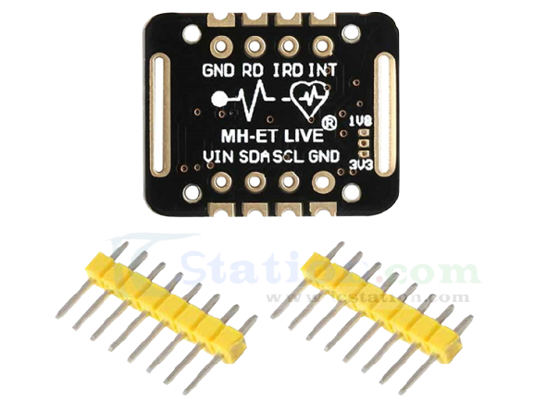
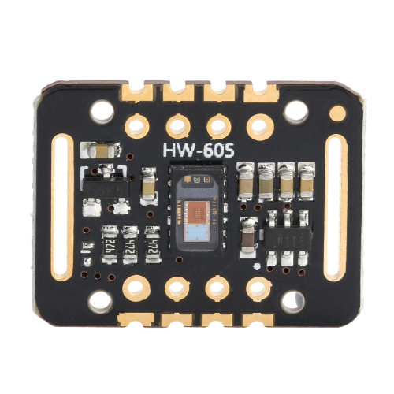
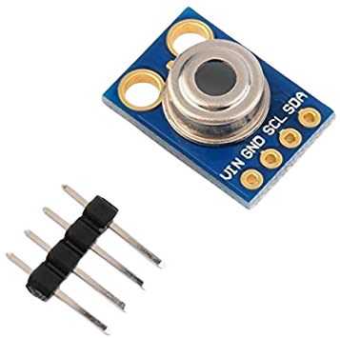
Components
Heart beat sensor(MAX30102) : This Sensor is designed to provide analog output of heart beat when a finger is placed on it. The output of this sensor can be connected to Raspberry pi directly to measure the heart beat and O₂.
Temperature sensor(MLX90614): To measure the body temperature and room temperature. This can be an analog type of temperature Sensor. This sensor Measures the temperature between -40° C to +125˚C for sensor temperature and -70°C to +380˚C for object temperature.
Arduino Uno: Arduino board are able to read inputs light on a sensor, turning on LED and buzzer.
Fig.1 MAX30102 Sensor front and back side
Fig.2 MLX90614 Sensor

Slide 6
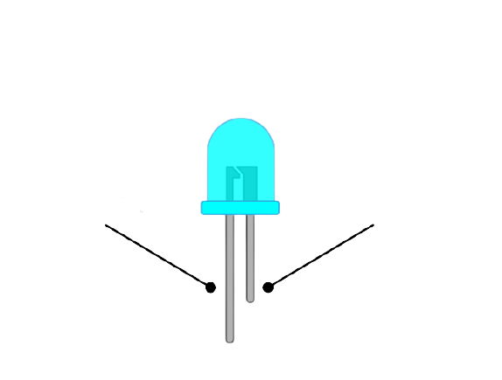
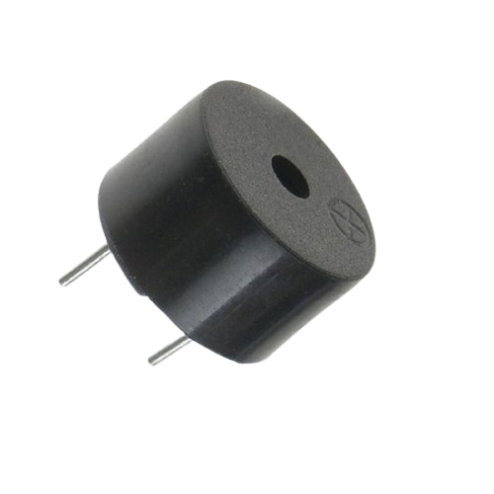
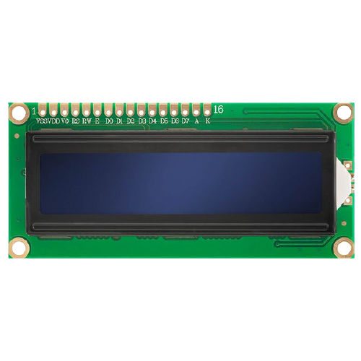
Components
Raspberry pi: It is programmable computers that include GPIO pins that can be used to connect and control external devices, and to create IoT solutions.
LED: LED can be used to indication emergency and normal condition.
Buzzer: Buzzer can be used to give indication about the parameter crossing a threshold value.
LCD Display: LCD display is used to show messages like reading of sensor data. We used 16×2 alphanumeric display.
Positive Anode(+)
Negative Cathode (-)
Fig. 3 LED (Light emiting diode)
Fig.4 Buzzer
Fig.5 16x2 LCD Display

Slide 7
Working Principle
In this project, MAX30102 sensors will measure the heart rate, oxygen level, and MLX90614 measure temperature of the patient and Room.
Continuously measured data will be monitored on LCD by the doctor and medical staff and Data will be upload in cloud using IOT, It can be accessible for hospital staff and doctors any place.
For the normal condition the heart rate should be between 60 to 100 bpm, Body temperature should be 36.5°C to 38.5°C, Spo2 level should be about 95%. If the parameters will be out of this range there will be an emergency condition.
When the emergency condition will occur the red led will turn on, Green light will off, and the buzzer will ring continuously.

Slide 8
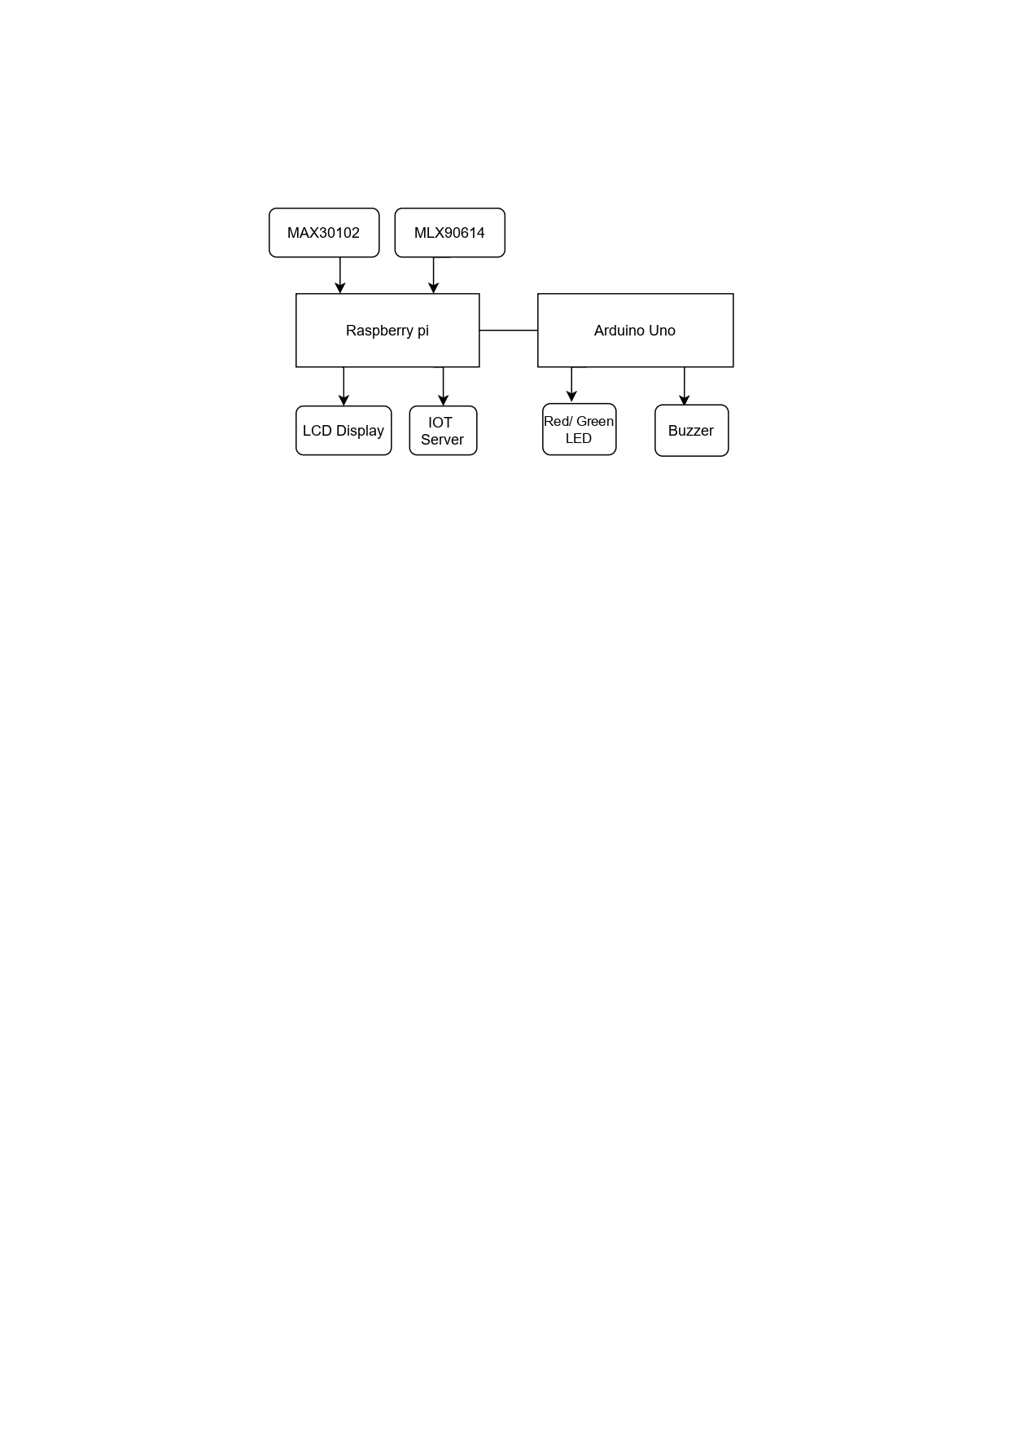
Block Diagram
Fig. 6 Block diagram of health monitoring system

Slide 9
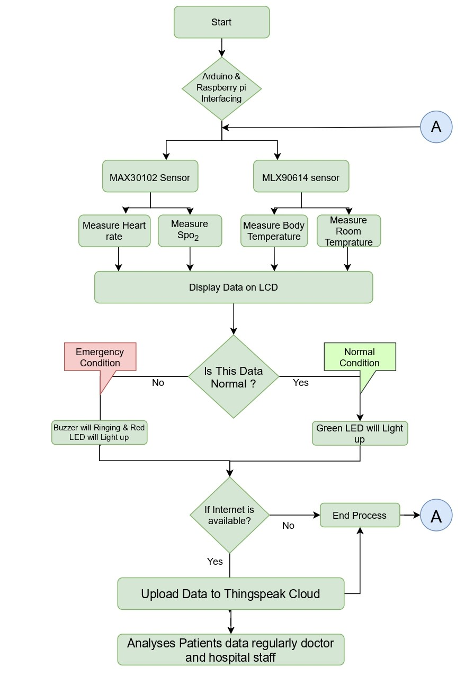
Flow Chart
Fig. 7 Flow chart

Slide 10
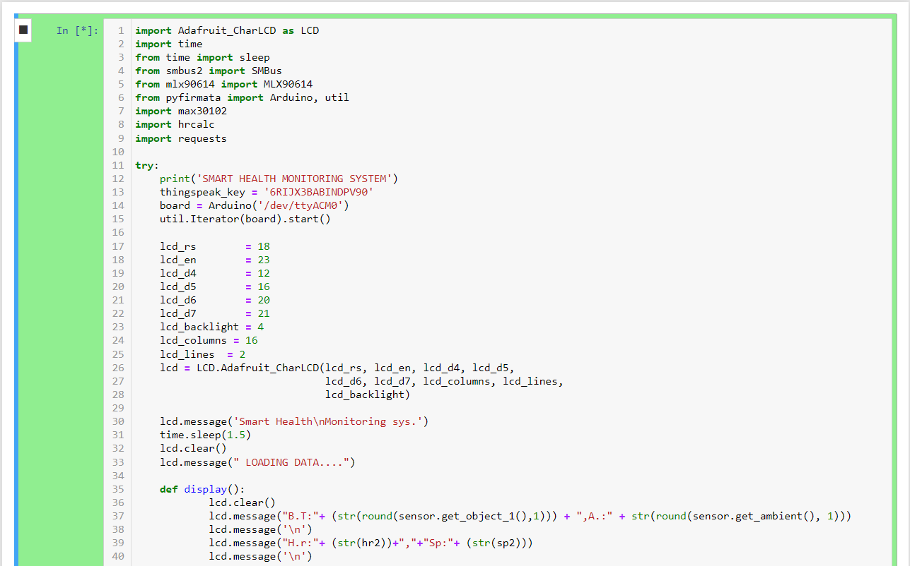
Source Code

Slide 11
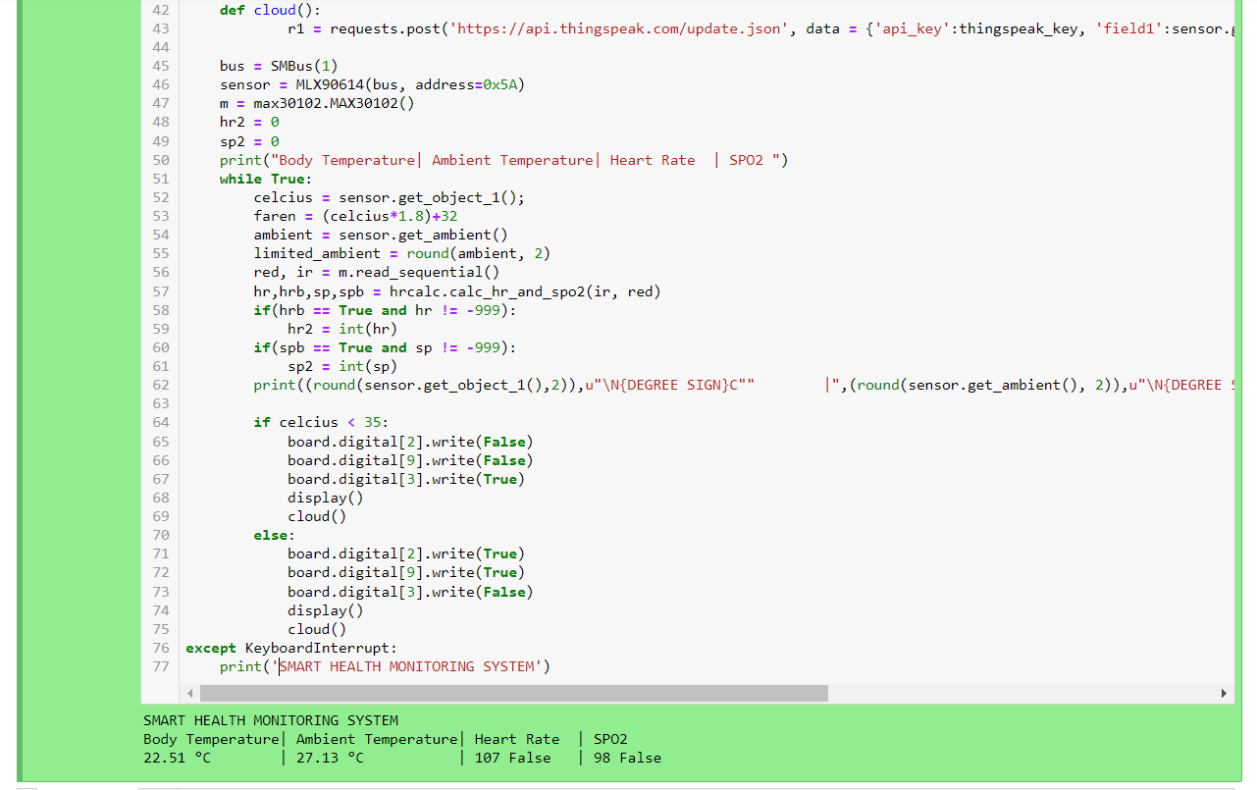
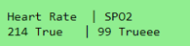
Continue…

Slide 12
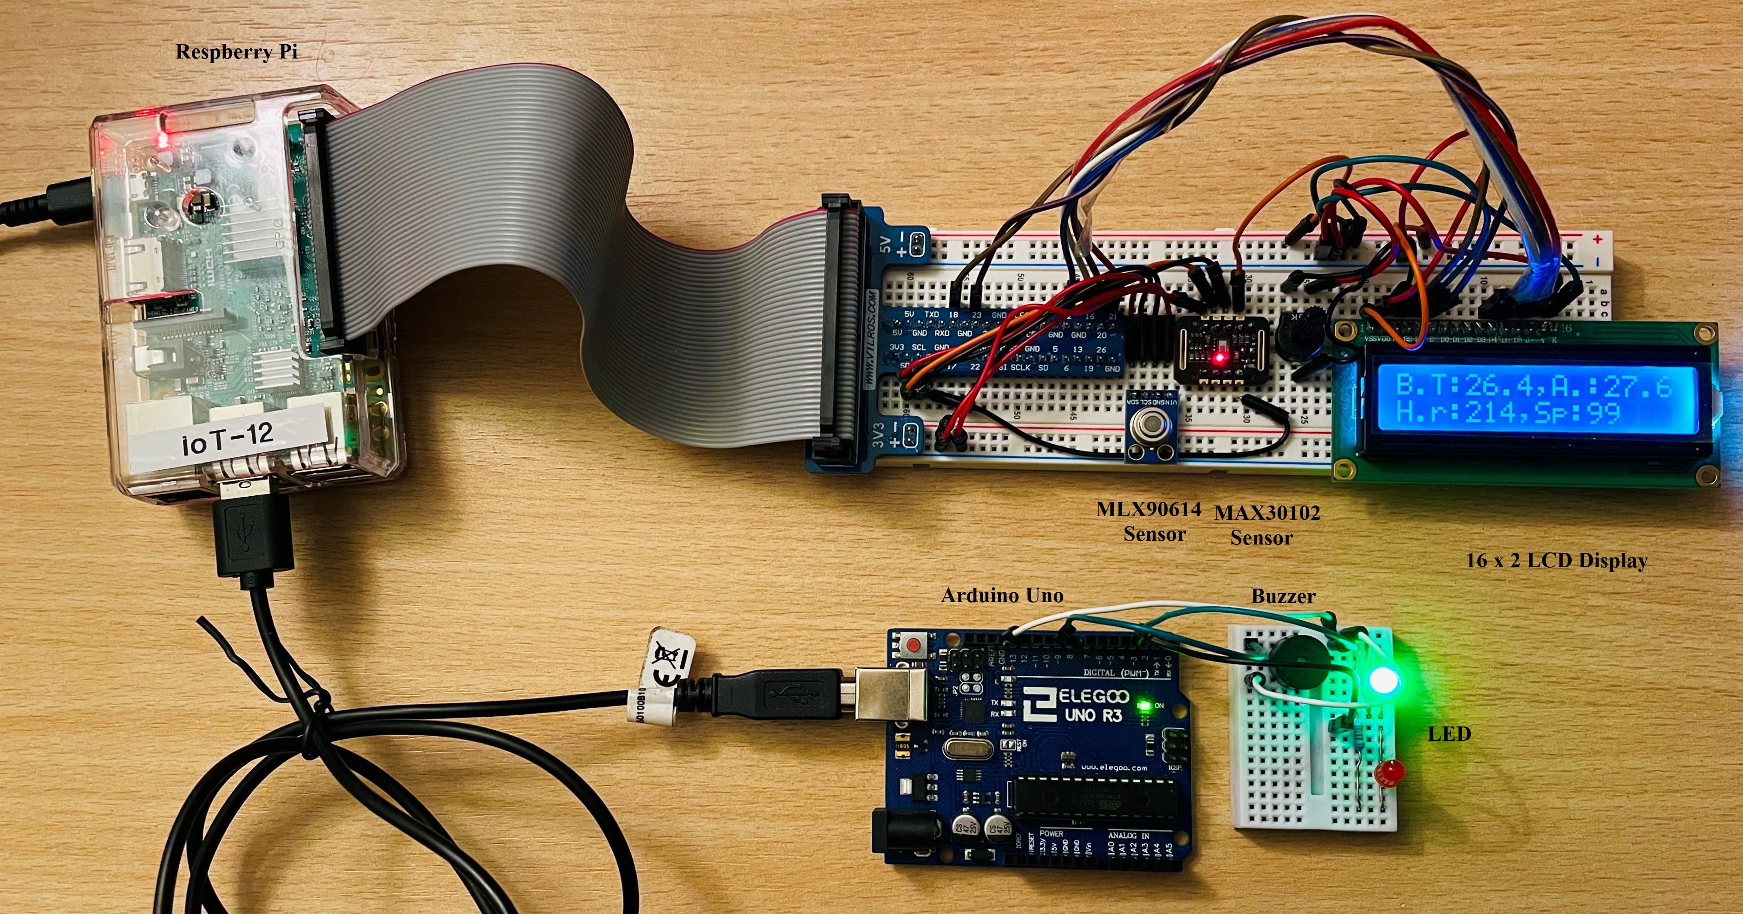
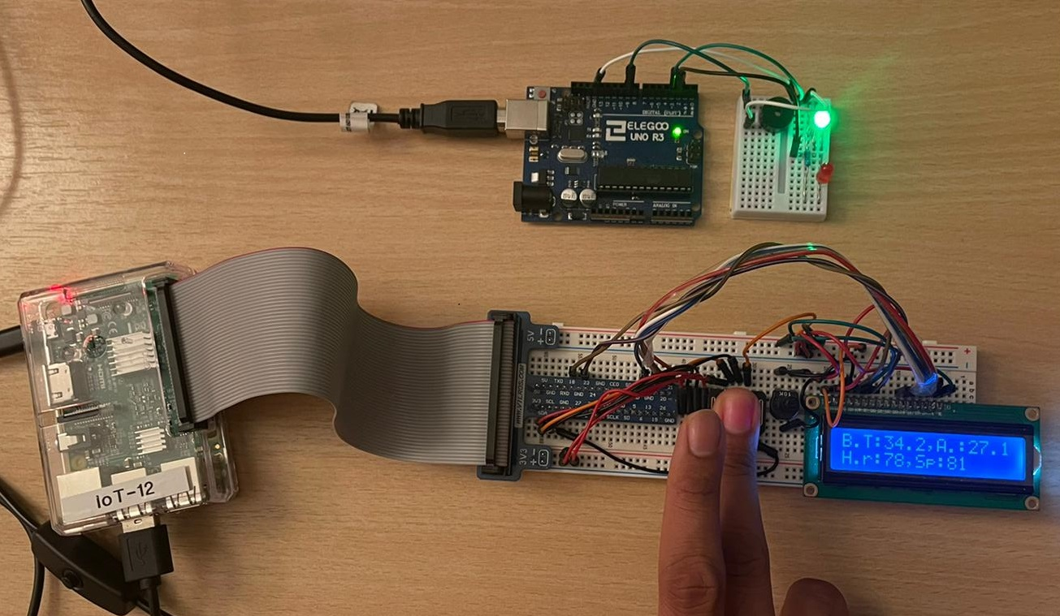
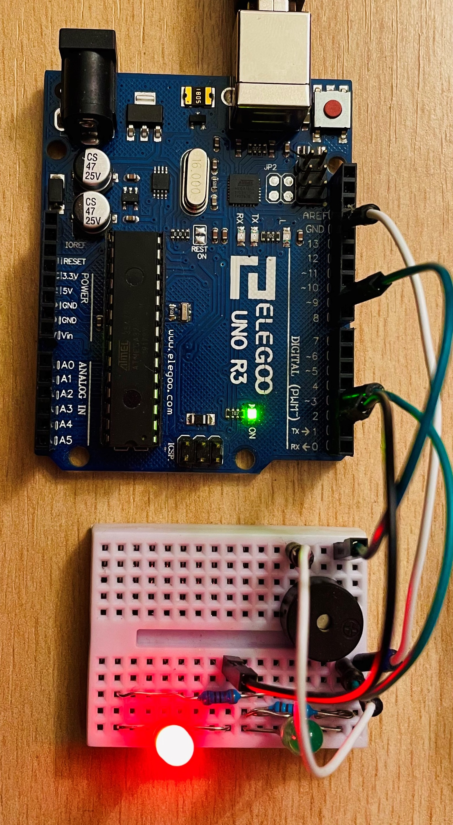

Hardware
Fig. 8 Health monitoring system working model in Normal Condition
Fig.9 Emergency Condition

Slide 13
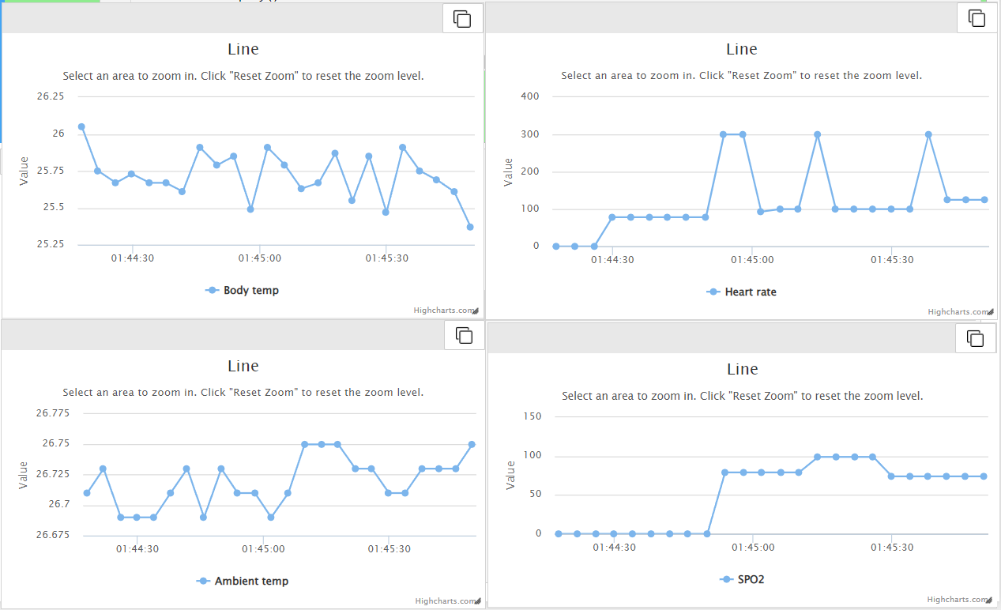
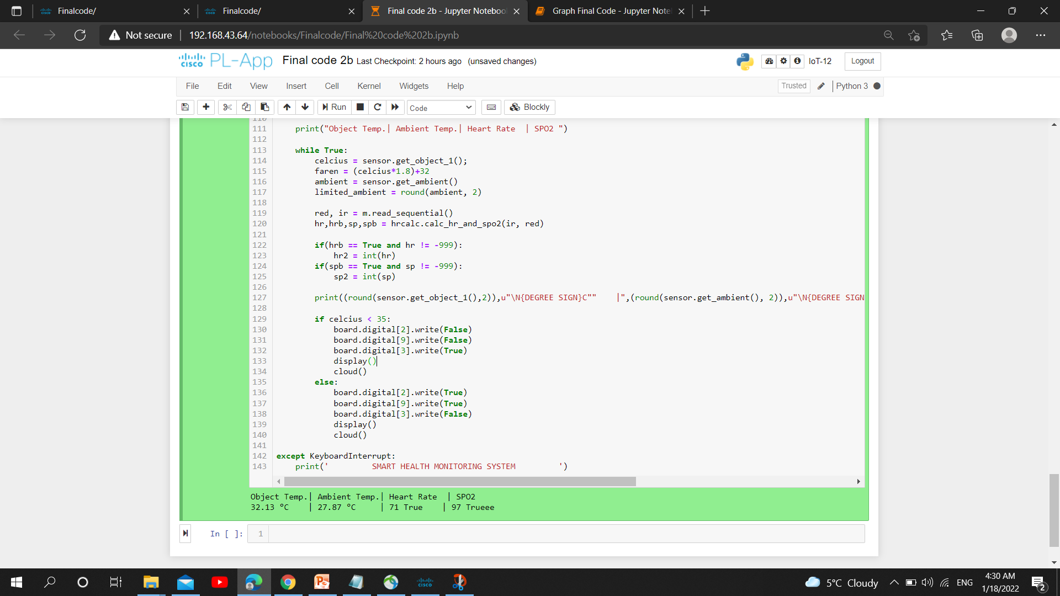
Result
Fig.10 PL-App Result

Slide 14
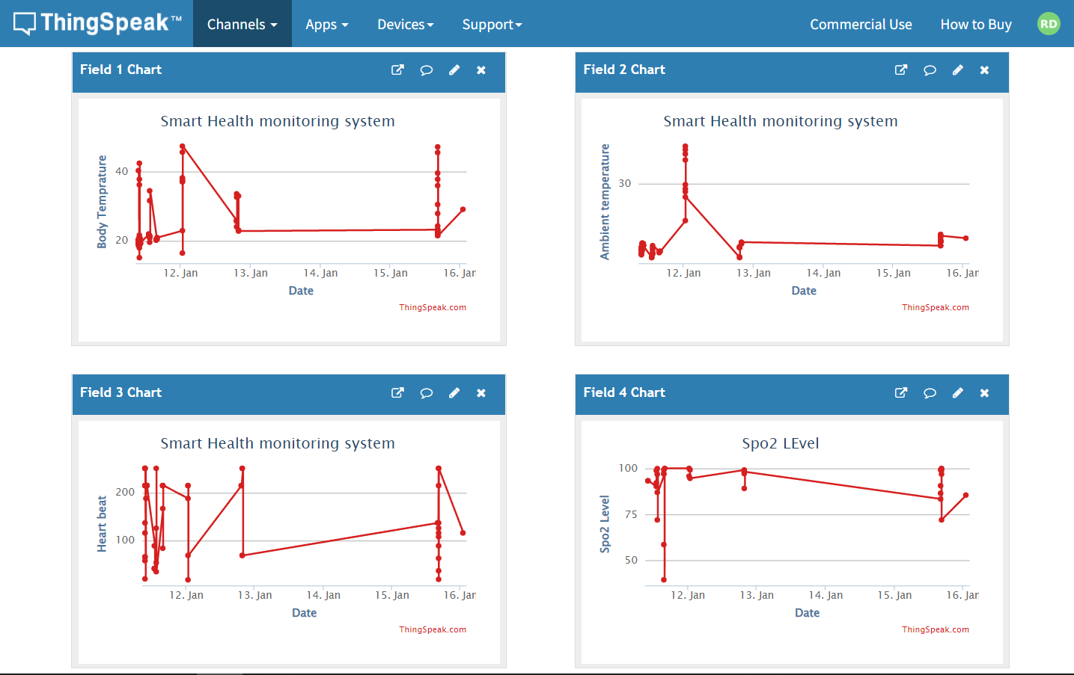
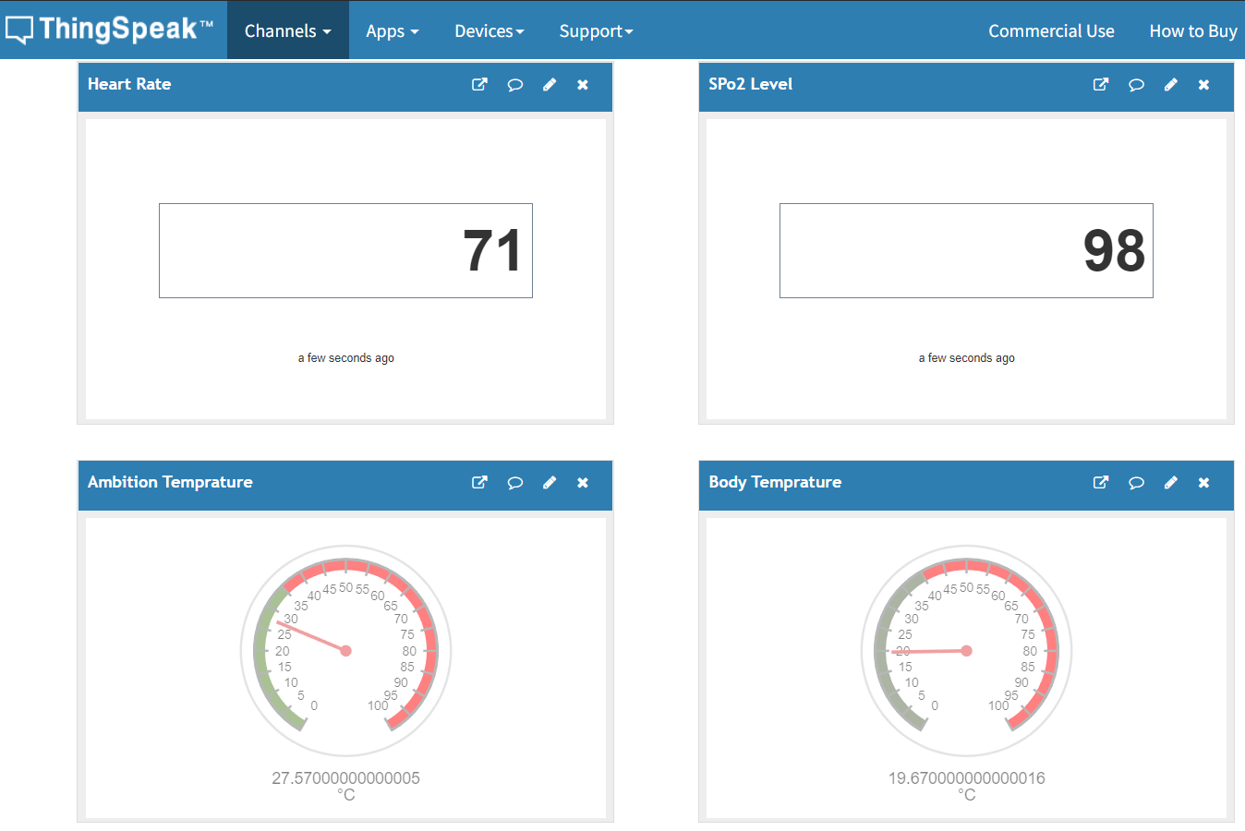
Result in Cloud
Fig.11 ThingSpeak Result

Slide 15
Future Scope
In Future, Smart Health Monitoring System is reduce health care costs by reducing physician office visits, hospitalizations, and diagnostic testing procedure.
Smart Hospitals.
Common thing on a global scale, and reduced physical visits to hospitals – this is only an approximate picture of the IoT success.
As per the information given by Grand View Research, the global IoT remote health monitoring market is expected to make more than $300 billion by 2022.

Slide 16
Thank You !

